Slide 1


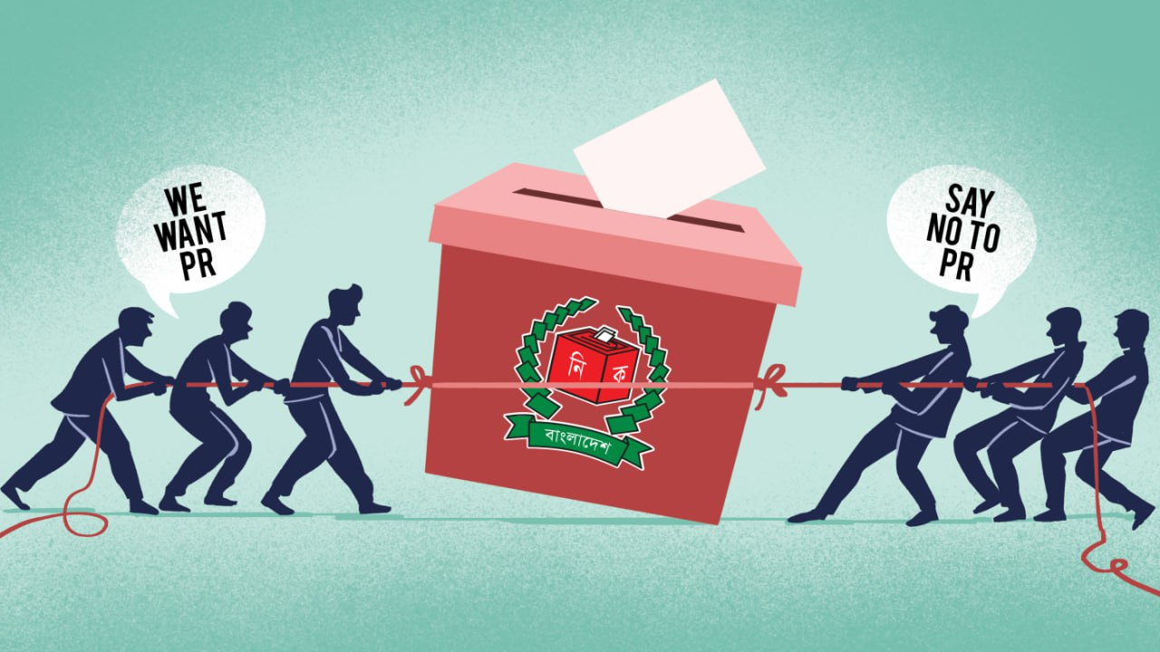
Proportional Representation (PR) System

Slide 2
Proportional Representation (PR) System
Presented By
Presented to
Name: James Amin
ID: 0242310005101596
Name: Hridoy Hasan
ID: 0242310005101826
Name: MD.RAGEB ROWNOK
ID: 0242310005101703
Name: Tasnuva Arif
ID: 0242310005101705
Name: Mr. Shah Md Tanvir Siddiquee Designation: Assistant Professor Department of CSE
Daffodil International University

Slide 3




Contents
01
01
02
What is PR? How PR Works & Its Possible Impact in Bangladesh.
Why Bangladesh Could Benefit from Proportional Representation?
03
03
Challenges and Criticisms of PR in the Bangladeshi Context.
04
Is PR Right for Bangladesh? Debates and Takeaways

Slide 4

What is PR System?
Proportional Representation (PR) is an electoral system where seats in parliament are allocated to political parties based on the percentage of votes they receive.
01
List PR
02
Mixed-member PR
03
Single Transferable Vote (STV)

Slide 5


How PR Works
Voting Process
Seat Allocation
Citizens vote for a political party instead of just an individual candidate
Parliament seats are distributed proportionally to the percentage of votes each party receives
Counting Votes
Party Lists
Each party’s percentage of total votes is calculated.
Each party prepares a list of candidates before the election

Slide 6

Possible Impact of PR in Bangladesh
01
01
More complex system
Fair system
02
02
Less focus on local areas
Every vote counts
03
More voices in parliament
03
Parties may need to share power
04
Reduces single-party control
04
Too many small parties

Slide 7



Why Bangladesh Could Benefit from Proportional Representation?
01
Broader Political Inclusion
02
More Equitable Representation
Small parties get representation
Every vote counts
Fair share of seats = fairer outcome
Seats match vote %
Less vote wastage
Better reflection of public opinion
03
Limits Political Monopoly
One-party dominance reduced
Coalition encourages inclusivity
Checks and balances improve governance

Slide 8


Why Bangladesh Could Benefit from Proportional Representation?
04
Successful Global Examples
05
Builds Public Trust
Sweden, South Africa, Switzerland
Higher trust, more diversity
More women & minority representation
Every vote has impact
Voter turnout likely to increase
More engagement in democratic processes

Slide 9



Challenges and Criticisms of PR in the Bangladeshi Context
01
02
03
Risk of Political Gridlock
Rise of Extremism
Complexity for Voters
Fragile coalitions
Slow decision-making
Problematic during crises
Fringe parties may gain power
Risk of radical policies
Just a few % votes = seats
Dual ballots, thresholds
Hard to understand
Risk of disengagement

Slide 10
Challenges and Criticisms of PR in the Bangladeshi Context
04
05
Weak Local Accountability
Cultural & Practical Concerns
Fewer MPs tied to specific areas
Less direct accountability
More party loyalty than people loyalty
FPTP is deeply rooted
Sudden shift may cause unrest
Needs careful and gradual reform

Slide 11
Is PR Right for Bangladesh? Debates and Takeaways
Current Political Debate
Conflicting Views
01
02
Advocates: Stronger democracy
Critics: Weak governments, messy coalitions
Public & expert opinion is divided
Post-election PR interest rising
Goal: End dominance, ensure fairness
Risk: Fuel political instability
A Mixed System?
Final Reflections
03
04
FPTP + PR = Balanced model
Local + proportional representation
Used in Germany, New Zealand
PR: Fair, inclusive, diverse
But: Complex, risky, needs planning
Requires education + cooperation

Slide 12


Conclusion
May lead to slower decision-making
Allows small or fringe parties to gain seats
Involves more complex voting processes
Reduces direct MP–voter connection
Represents a significant shift from current practice

Slide 13
Thank You

